Slide 1
Employer as data controler
Commissioner for Information of Public Importance and Personal Data Protection of Republic of Serbia
Sarajevo 11.-12.05.2016.

Slide 2
OVERVIEW OF THE SITUATION IN SERBIA IN THE FIELD OF EMPLOYMENT
Main traits:
high unemployment officially at around 18% (youth unemployment almost 50%)
low wages (around 370eur average net)
transitional economy
specifics of the labor market (employee leasing, complex employer structure, contract work …etc.)

Slide 3
DISBALANCE OF POWER AS A PRESUMTION
Labor market in Serbia has an inherent flaw – the overwhelming disbalance of power between the employer and the employee.
In order to get a job or to keep a job, employee is willing to put his privacy and his personal data at the disposal of the employer, compliciting to the illegal data processing.

Slide 4
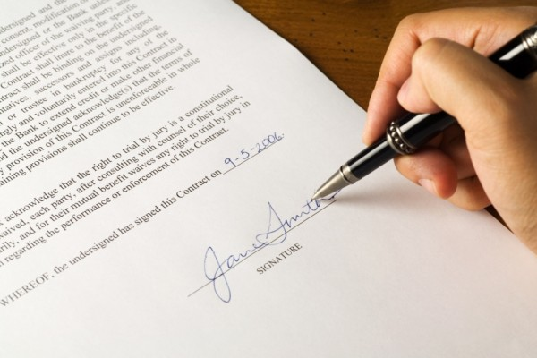
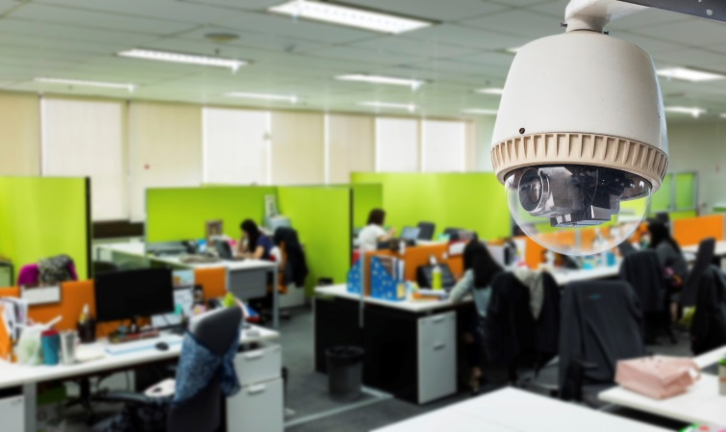
PRESUMPTIONS FOR THE LEGALITY OF THE PERSONAL DATA PROCESSING
Legal basis
Adequate information for the employee
Necessity of the personal data processing for the specific legitimate purpose
Right balance between the rights of data subject, and interests of the employer

Slide 5
LEGAL BASIS – IS THE CONSENT POSIBLE?
Legal basis for the personal data processing:
Consent of data subject/employee
Permitted data processing without a consent of data subject (processing needed in order to fulfill the labor contract / legitimate interest of the employer)
Obligations / authorization from other laws
Disbalance of power between parties, and the toxic environment that`s present at the labor market, raises question about legality of the given consent – is the employee free in giving his consent, can the
consent be considered valid?
In all cases the employer is obliged to inform
the employee in detail and fairly about data
processing he is under at his workplace/related to
the work.

Slide 6
LAW AUTHORISATION AS A LEGAL BASIS FOR PERSONAL DATA PROCESSING
Labor law
Law on civil servants
Other laws (Anti-discrimination law, Law on health insurance, Law on safety and health on work… etc.)
Labor law:
Article 15. employee is obliged to inform the employer about relevant circumstances which can influence, or could influence his job performance, and fulfillment of tasks stipulated in the work contract.
Article 18. law forbids any kind of discrimination in relation to gender, birth, language, skin color, pregnancy, health status, nationality, faith, martial status, sexual orientation, political affiliation… etc.
Article 26. candidate is obliged to submit papers and other proof of his qualifications for the job he is applying for, according to those stated in the employers documents for the specific work position. The employer can not demand the candidate to submit personal data about his personal and family life, martial status, family planning, or the information and documentation which are not in direct connection to the job he is applying for.
Article 83. the employee has a right to demand an insight into documentation with his personal data, kept with the employer, with a right to demand to erase data that is not directly needed for the purpose of employment, or to correct false data. Employees personal data can not be made disclosed to a third party, unless it is stipulated by the law.

Slide 7
FINE BALANCING ACT
Finding the right balance between legitimate interests of the employer and personal rights of an individual employee is crucial when determining whether personal data processing is legal or not.
Obligation of the data controller, and a challenge for the Commissioner

Slide 8
OTHER CHALLENGES IN THE COMMISSIONER`S WORK
Number of data controllers (registered legal entities in Serbia: 120.892, registered entrepreneurs: 217.035)
Uninformed data controllers and data subject about obligations, rights and limitations in personal data processing
Unwillingness of data subjects to rapport violations
New technology and innovative data processing (biometrics, tracking programs, GPS tracking, video surveillance… etc.)
Personal data transfer abroad (foreign ownership)

Slide 9
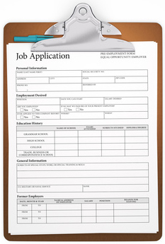
EXAMPLE 1. – RECRUTING PROCESS
Commissioner received a complaint in regards to extensive data processing of personal data during the application process for vacant job position with the employer.
Commissioner conducted a supervision, finding that the employer has been collecting personal data from job appllicants, asking them to fill out a form with fields such as: nationality, martial status, number of family members in the same household, ownership of the property in which the candidate is living in, age and number of children, who can take care of children in case
of illness, financial situation of the candidate, number of cups
of coffee, cigarettes and alcohol drinks candidate consumes
during one day, religion that the candidate practices… etc.
Commissioner concluded that the data processing was
excessive and without a clear purpose.

Slide 10
EXAMPLE 2. – BIOMETRICS AT THE WORKPLACE
Commissioner received an anonymous complaint that an employer is misusing fingerprints of its employees in order to track their movement.
Commissioner conducted a supervision and found out that an employer decided to implement a biometric system for the purpose of evidencing the employee presence at the workplace (coming in at work and leaving work). Implemented system consisted of id cards with crypted fingerprints being directly stored on them, without keeping any data with the employer. Employee was obliged to lean the card and the finger on the scanner when entering the building, that as an activity being stored in the employers database. The system was not compulsory.
Commissioner concluded that data processing
was legal, because there was sufficient legal
ground for data processing, employees were
adequately informed and had a right to opt out.

Slide 11
EXAMPLE 3. – KEYSTROKE TRACING/SCREENSHOT MAKER PROGRAM
Commissioner received a complaint from a union of a state utility company, that the director installed a program on all of the computers of the employees that tracks their activity.
Commissioner conducted an investigation and found out that director ordered technical staff to install a program on all of the computers of employees, which traced keystrokes, made screenshots, logged activity …etc. The system was being implemented in order to prevent misuse of resources
and to tighten the discipline. Employees were verbally
informed that “everything will be tracked”.
Commissioner concluded that the data processing was
extensive for the defined purpose.

Slide 12
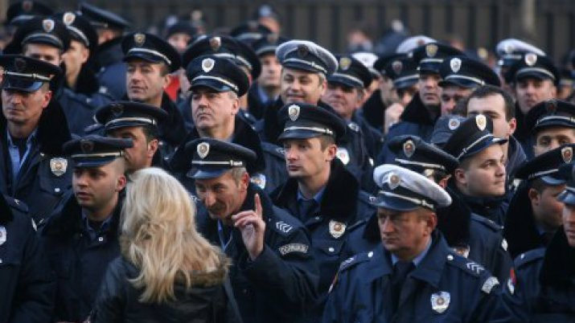
EXAMPLE 4. – INTERIOR MINISTERY, MASSIVE DATA PROCESING FOR PURPOUSE OF „RATIONALISATION„
Commissioner received a complaint from the law enforcement union, that the Ministry of interior affairs started collecting vast amounts of personal data of its employees, for the purpose of „rationalization“ of more than 1000 people employed by the Ministry.
Commissioner conducted an investigation, and found out that the Ministry began to collect various personal data of the employees, including sensitive personal data (convictions, medical data, etc…), on the basis of the newly adopted rulebook.
Commissioner concluded that the data processing
was unauthorized, because the rulebook only, can
not be a valid legal basis for the personal data
processing.

Slide 13
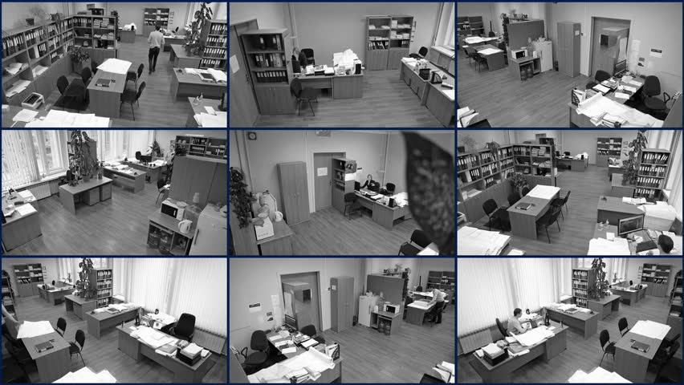
EXAMPLE 5. – VIDEO SURVAILANCE IN THE MUSEUM
Commissioner received a complaint from the employees of the museum that they are being video surveyed.
Commissioner conducted an investigation and discovered a video surveillance system which was set to cover public spaces in the museum for the purpose of security, but it as well covered administrative offices of the museum, for the purpose of controlling the work of the employees. Video surveillance system was connected to the director`s computer who had a direct access to video stream, as well as access to the recordings.
Commissioner concluded that the video
surveillance system set in place allowed for
excessive personal data processing of
employees.

Slide 14
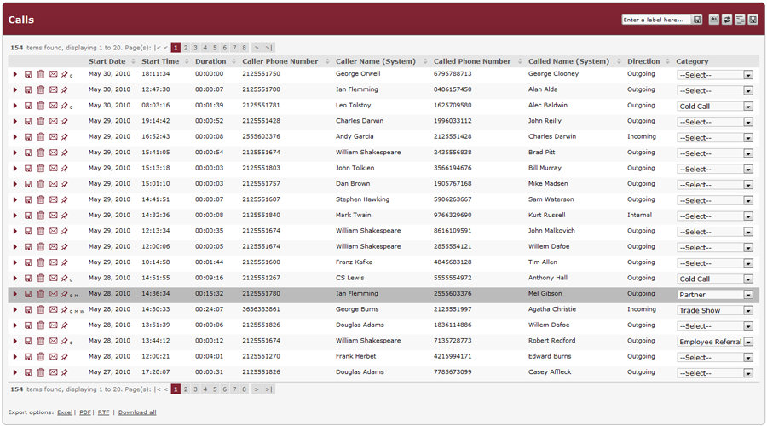
EXAMPLE 6. – BUSSNESS PHONE CALL LISTING
Commissioner received a complaint from an employee, that his employer has obtained call listing made from his business phone.
Commissioner conducted an investigation and discovered that an employee was informed in advance that the phone which he was given by the employer for the work purposes, was to be used for business purposes only, and that the owner of the simcard – phone number which employee used, was the employer. The purpose of obtaining call listing was to control phone usage, because of unusually high bill.
Commissioner concluded that employer
obtained call listing legally and that
personal data that was processed, was
proportionate to the purpose.

Slide 15
MAIN ACTIVITIES OF THE COMMISIONER AIMED AT IMPROVIG THE SITUATION
Citizens/employees:
dissemination of information, education about their rights and encouraging them to rapport abuse of their personal data.
Employers:
consultative and educational work informing employers about their obligations and limits in personal data processing;
increased number of supervisions;
improving the legislature.

Slide 16
THANK YOU FOR YOUR ATTENTION
Commissioner for Information of Public Importance and Personal Data Protection of Republic of Serbia
Belgrade, str. Bulevar karalja Aleksandra no.15
Tel. 011/34-08-900
www.poverenik.rs
office@poverenik.rs
My contact:
Bojan Marsicanin – independent advisor
in Department I of the Sector for supervision
of the Commissionaire's office.
bojan.marsicanin@poverenik.rs

