Slide 1
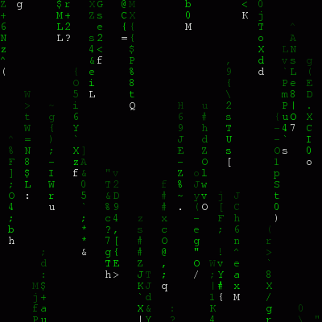
Commissioner for Information of Public Importance and Personal Data Protection
42 Svetozara Markovića str. Belgrade 11000 Republic of Serbia

Slide 2
LAW ON PERSONAL DATA PROTECTION
Organisational and Technical Measures
Article 47
Data must be adequately protected from abuse, destruction, loss, unauthorised changes or access.
The controller and the processor are obliged to provide necessary organisational and technical measures for data protection, in accordance with prescribed standards and procedures, which are necessary to protect data from loss, destruction, unauthorised access, alteration, publishing and any other abuse, as well as to prescribe obligation of keeping the confidentiality of data for those who work on data processing.
ZAKON O ZAŠTITI PODATAKA O LIČNOSTI
Organizacione i tehničke mere
Član 47
Podaci moraju biti odgovarajuće zaštićeni od zloupotreba, uništenja, gubitka, neovlašćenih promena ili pristupa.
Rukovalac i obrađivač dužni su da preduzmu tehničke, kadrovske i organizacione mere zaštite podataka, u skladu sa utvrđenim standardima i postupcima, a koje su potrebne da bi se podaci zaštitili od gubitka, uništenja, nedopuštenog pristupa, promene, objavljivanja i svake druge zloupotrebe, kao i da utvrde obavezu lica koja su zaposlena na obradi, da čuvaju tajnost podataka.

Slide 3
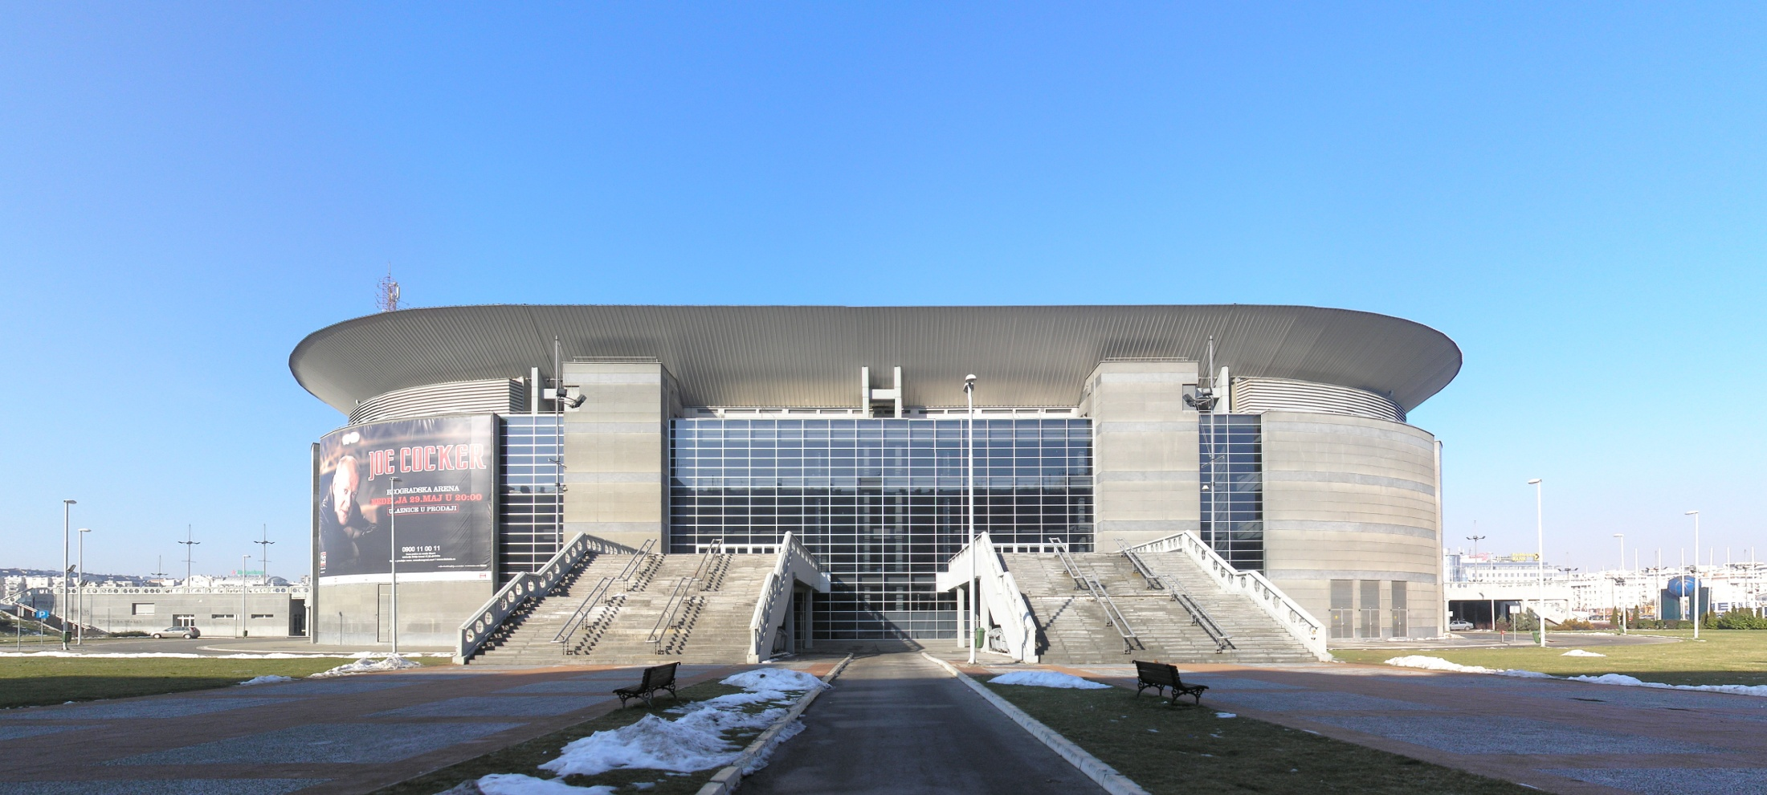
A R E N A
The Belgrade Arena (Serbian: Београдска арена / Beogradska arena), also known as Kombank Arena for sponsorship reasons, is an indoor arena located in Novi Beograd, Belgrade, and one of the largest indoor arenas in Europe.

Slide 4
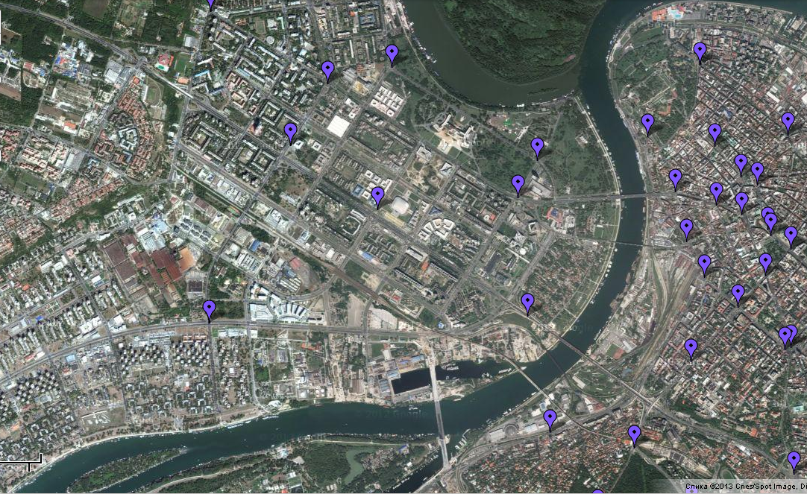
ARENA

Slide 5
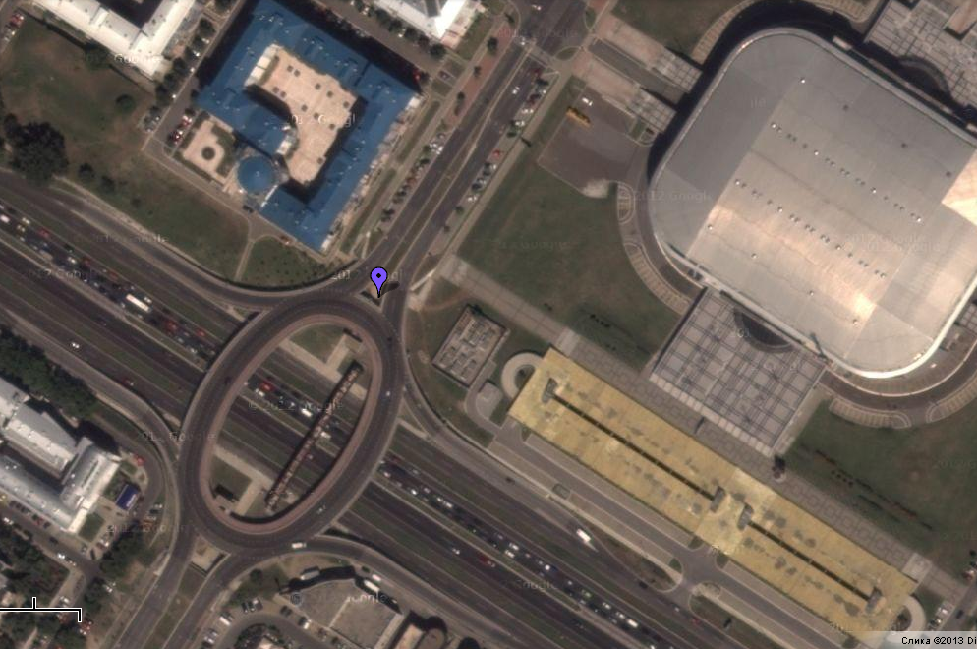
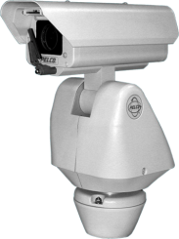
PTZ Camera Pelco ES30C/ES31C
Series Positioning System

Slide 6
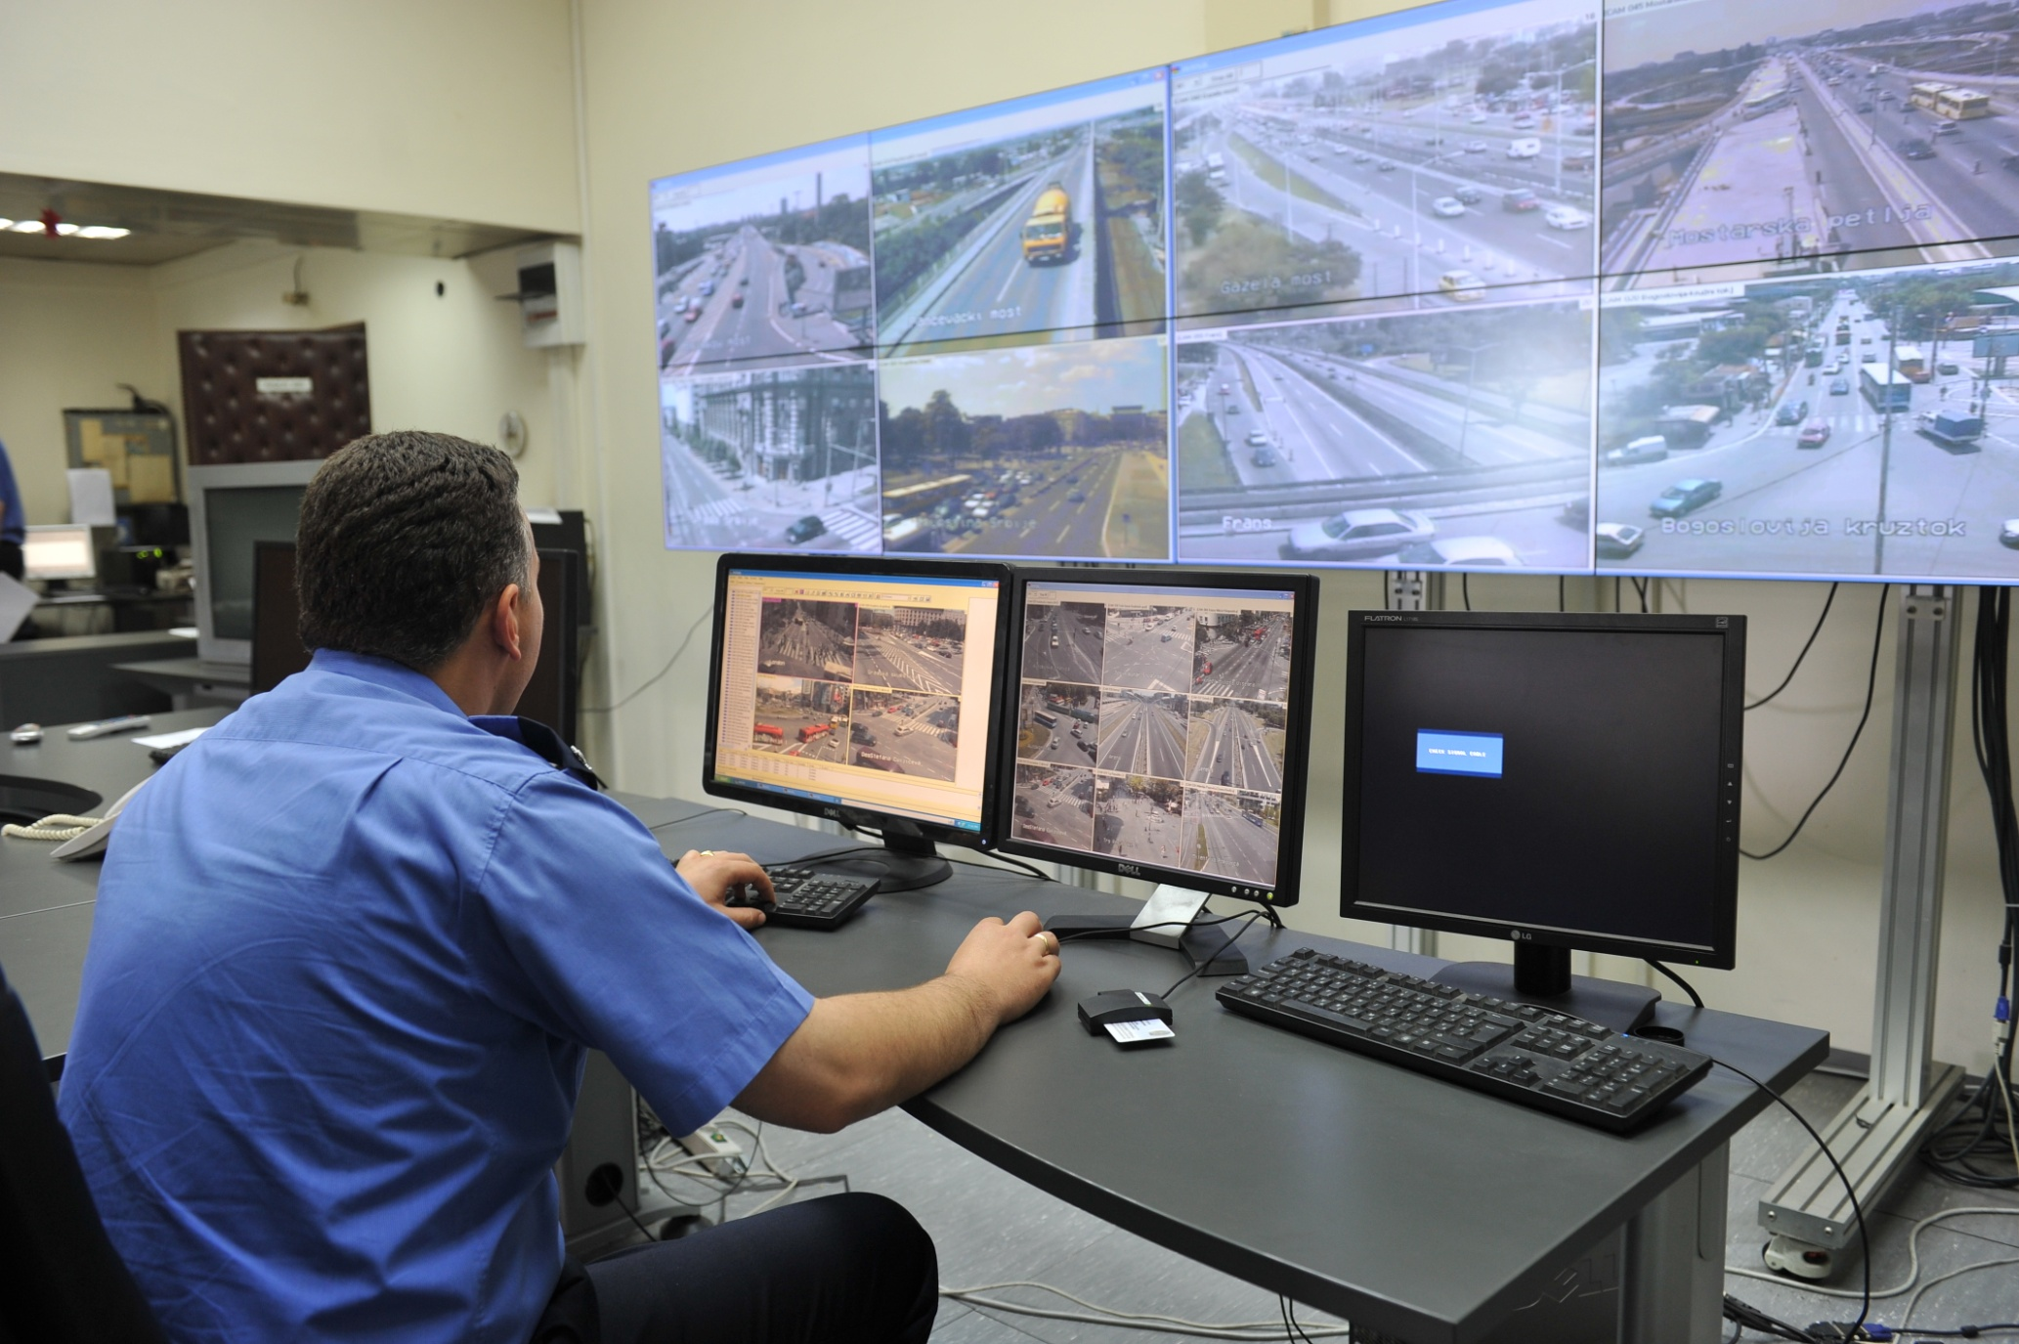

Slide 9
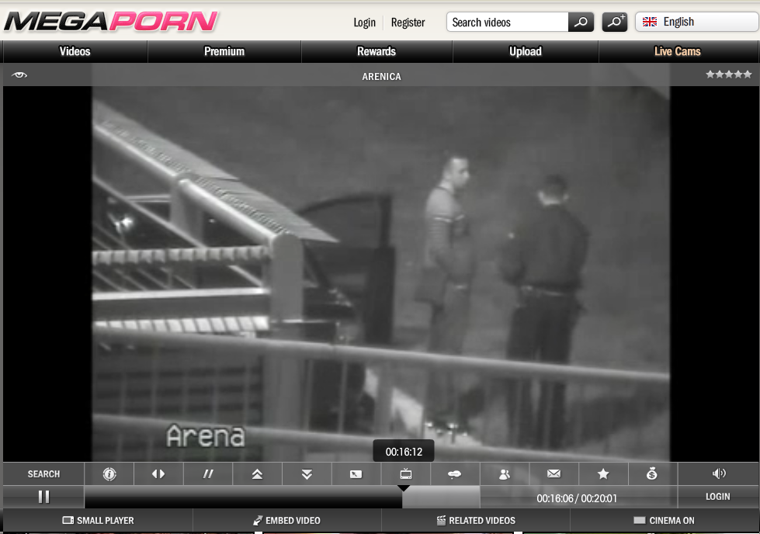

Slide 10
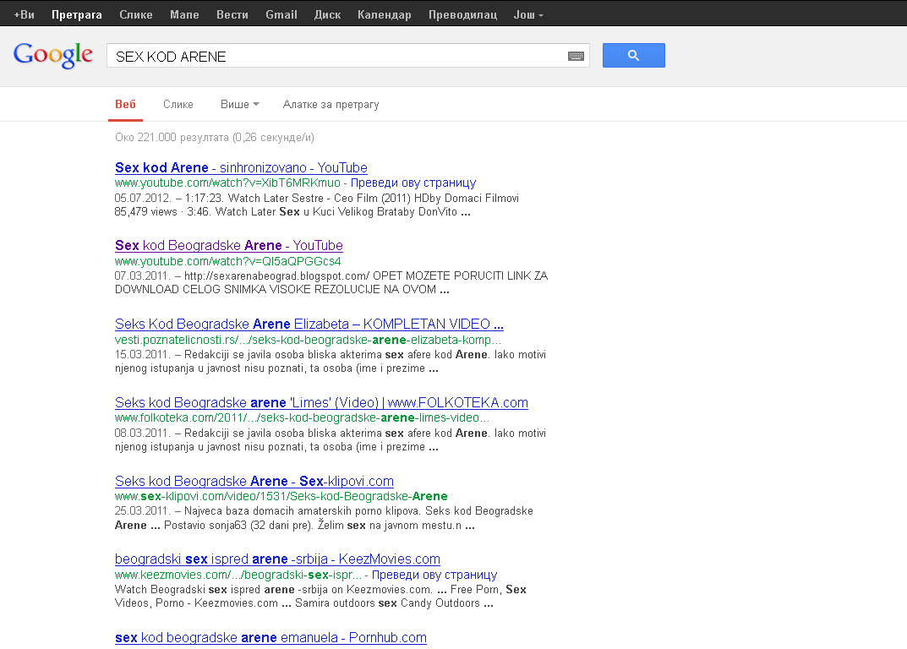

Slide 11
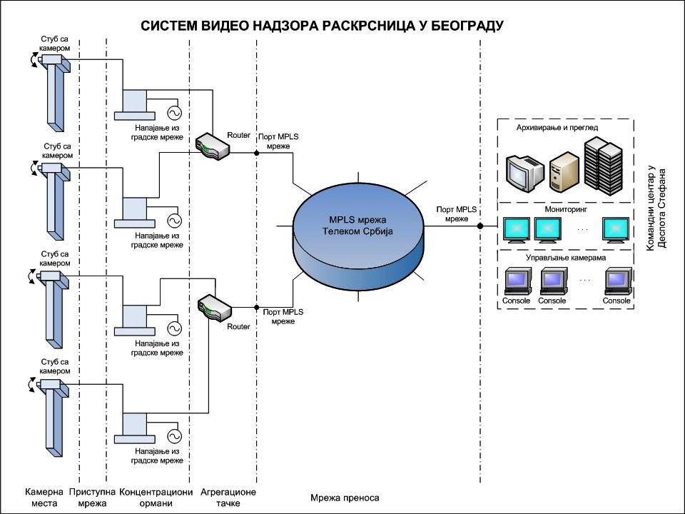

Slide 12
